Slide 1
5.2 More exponents
Algebra Concepts

Slide 2
Raising a Power to a Power
Rule:
Multiply the Exponents

Slide 3
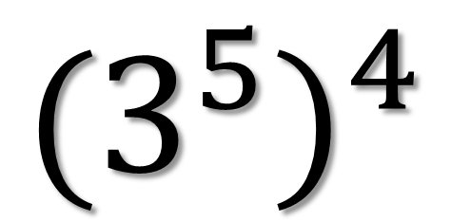
Example 1
$${(3^{5})}^{4}$$

Slide 4
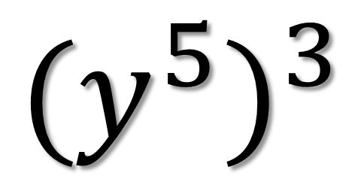
Example 2
$${(y^{5})}^{3}$$

Slide 5
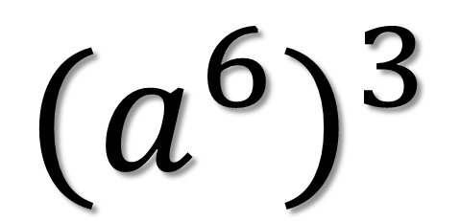
Example 3
$${(a^{6})}^{3}$$

Slide 6
Raising a Product to a Power
2n³ means
(2n)³ means

Slide 7
Raising a Product to a Power
Rule:
You must raise everything inside parentheses to the power! Distribute power!

Slide 8
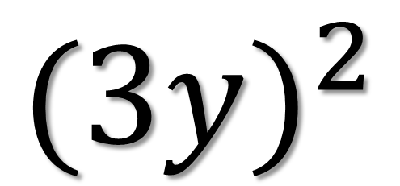
Example 4
$${(3y)}^{2}$$

Slide 9
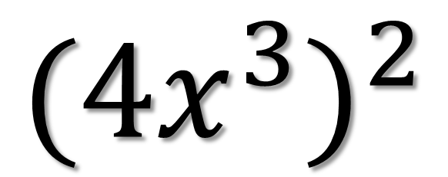
Example 5
$${({4x}^{3})}^{2}$$

Slide 10
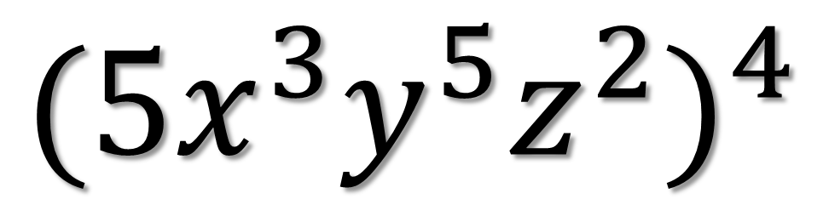
Example 6
$${({5x}^{3}y^{5}z^{2})}^{4}$$

Slide 11
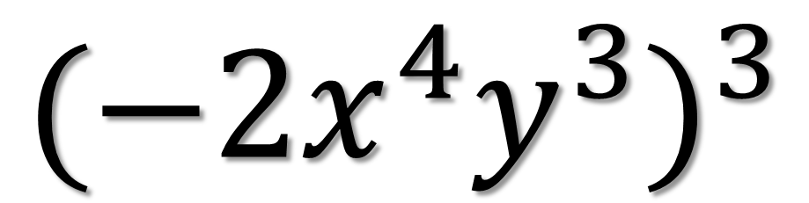
Example 7
$${({−2x}^{4}y^{3})}^{3}$$

Slide 12
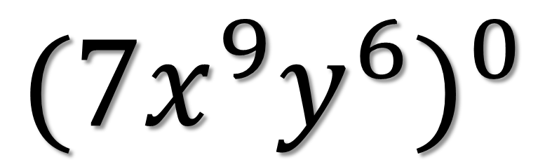
Example 8
$${({7x}^{9}y^{6})}^{0}$$

Slide 13
Raising a Quotient to a Power
Rule:
You must raise everything inside parentheses to the power!

Slide 14
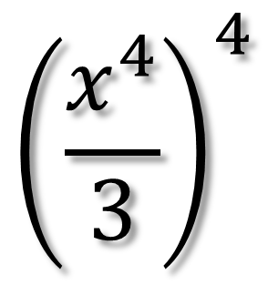
Example 9
$${\left(\frac{x^{4}}{3}\right)}^{4}$$

Slide 15
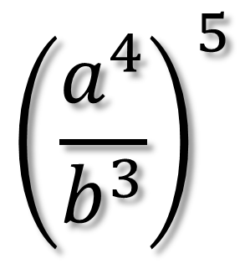
Example 10
$${\left(\frac{a^{4}}{b^{3}}\right)}^{5}$$

Slide 16
Example 11

